Slide 1
Chapter 8
Multiplexing
Many to one/one to many
Types of multiplexing
Telephone system
WCB/McGraw-Hill
© The McGraw-Hill Companies, Inc., 1998

Slide 2
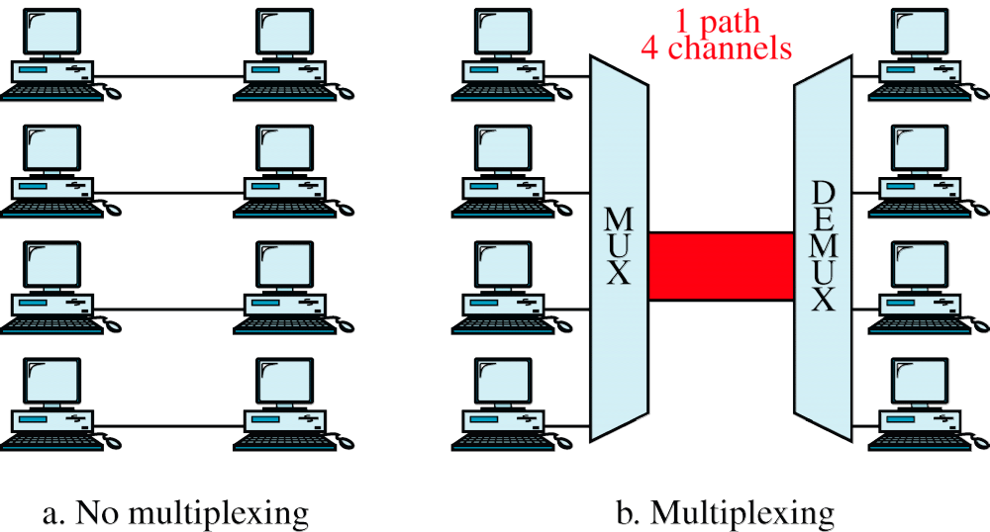
Figure 8-1
Multiplexing vs. No Multiplexing
WCB/McGraw-Hill
© The McGraw-Hill Companies, Inc., 1998

Slide 3
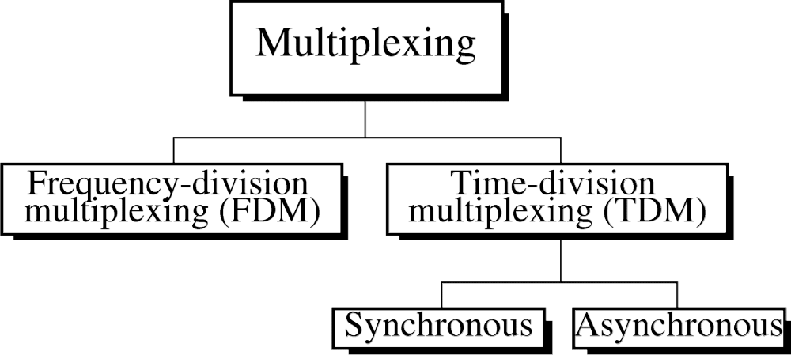
Figure 8-2
WCB/McGraw-Hill
© The McGraw-Hill Companies, Inc., 1998

Slide 4
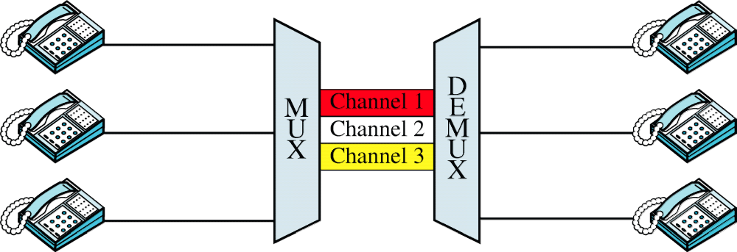
Figure 8-3
FDM
WCB/McGraw-Hill
© The McGraw-Hill Companies, Inc., 1998

Slide 5
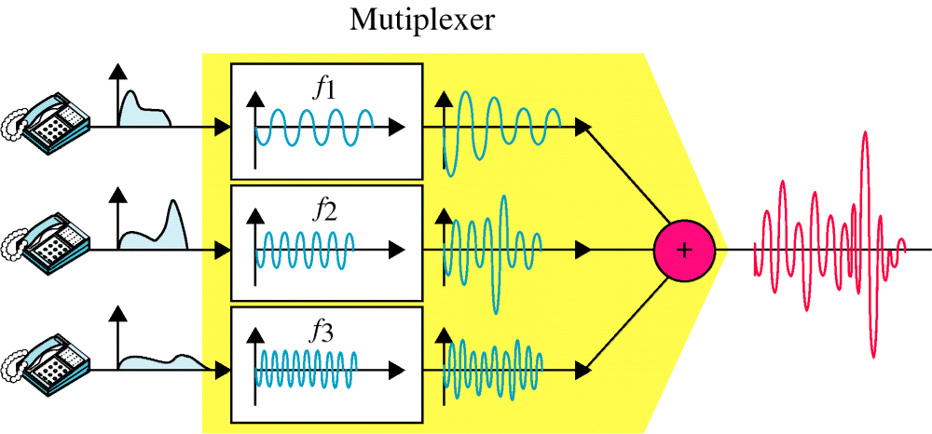
Figure 8-4
FDM, Time Domain
WCB/McGraw-Hill
© The McGraw-Hill Companies, Inc., 1998

Slide 6
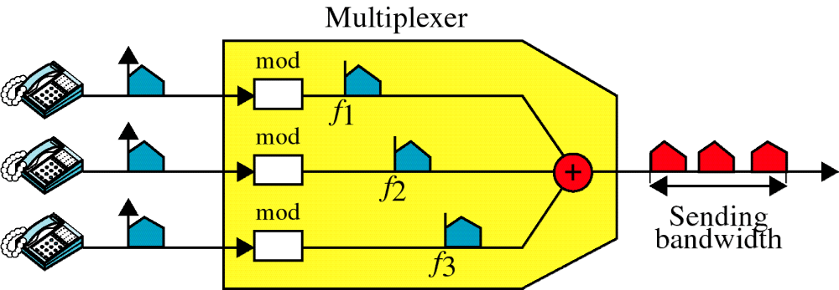
Figure 8-5
Multiplexing, Frequency Domain
WCB/McGraw-Hill
© The McGraw-Hill Companies, Inc., 1998

Slide 7
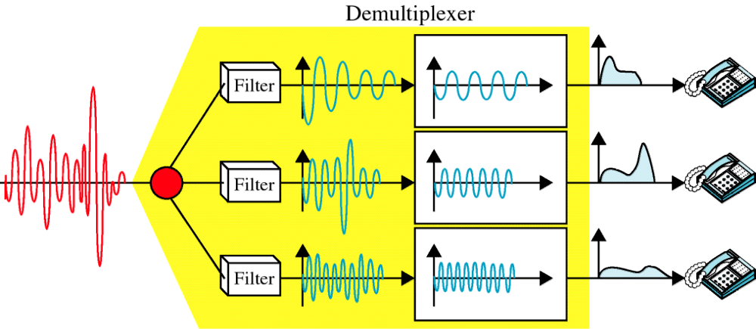
Figure 8-6
Demultiplexing, Time Domain
WCB/McGraw-Hill
© The McGraw-Hill Companies, Inc., 1998

Slide 8
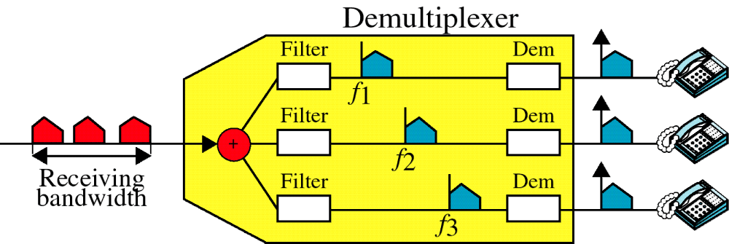
Figure 8-7
Demultiplexing, Frequency Domain
WCB/McGraw-Hill
© The McGraw-Hill Companies, Inc., 1998

